Slide 1
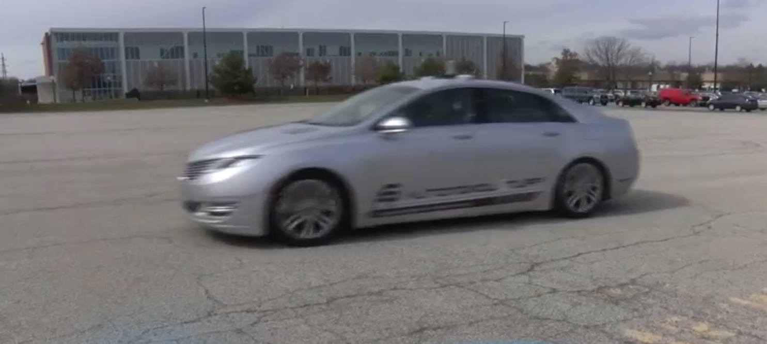
NO Need to Worry about Adversarial Examples in Object Detection in Autonomous Vehicles
Jiajun Lu*, Hussein Sibai*, Evan Fabry, David Forsyth
University of Illinois at Urbana Champaign
{jlu23, sibai2, efabry2, daf}@illinois.edu

Slide 2
Adversarial examples
“panda”
57.7% confidence
“gibbon”
99.3% confidence
Visually Similar
[Goodfellow et al. 2014]

Slide 3
Adversarial examples
“panda”
57.7% confidence
“gibbon”
99.3% confidence
In digital world: easy to construct and work rather well
In physical world: different viewing conditions make different image patterns
Distance, angle, lighting, camera transformation, noise and so on
[Goodfellow et al. 2014]

Slide 4
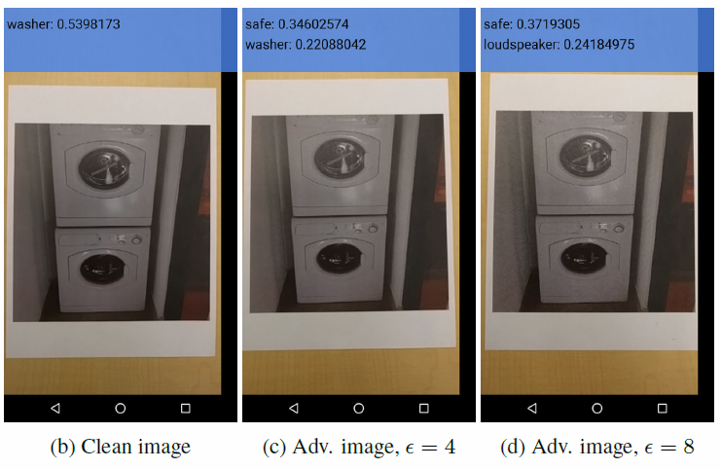
Do they work in physical setting?
[Kurakin et al. 2016]

Slide 5
Do they work in physical setting?
[Startup: https://cvdazzle.com/]

Slide 6
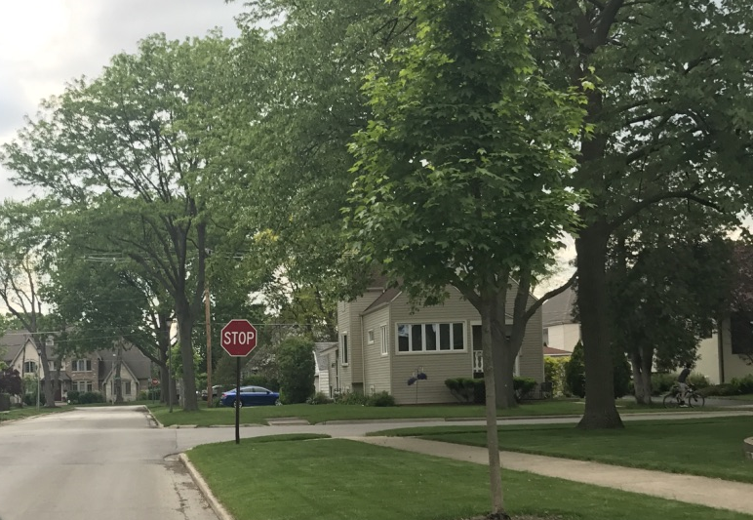
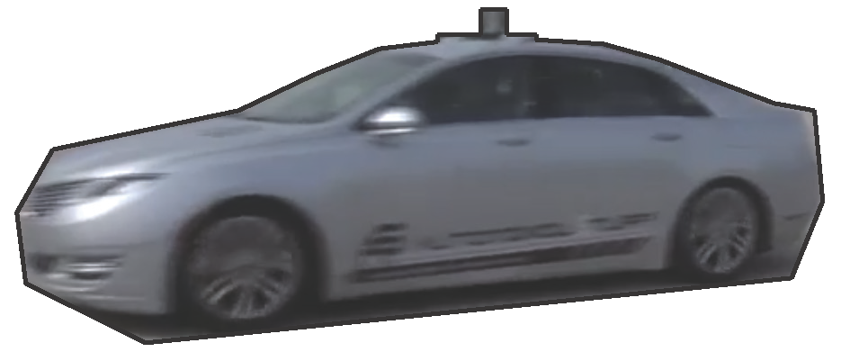
More realistic cases? Autonomous vehicles?
Should I stop?
Should I go faster?
Adversarial Attack
People worry about it!

Slide 7
Ideal attacking
Physical Adversarial
Stop Sign
Spray Paint with Template
Physical Stop Sign

Slide 8
Adversarial attacks by descent
Fast Sign method:
Iterative method:
Iteratively apply fast sign method with small step size
L-BFGS method:

Slide 9
Attacking
Detector
Attacking
Classifier

Slide 10
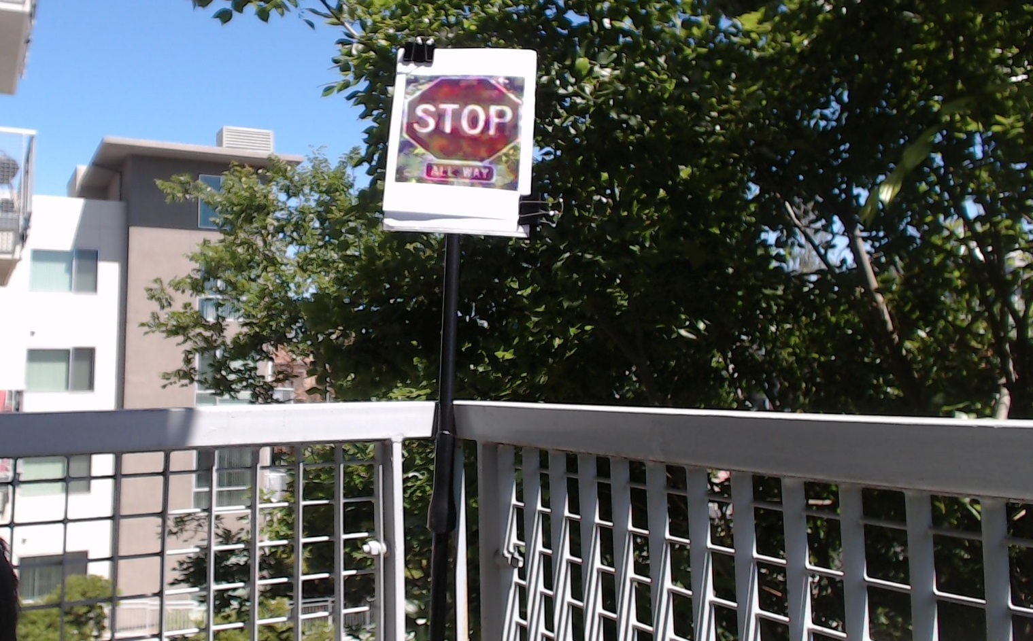
Simulated stop sign detection

Slide 12
Distance effects - quantitative results

Slide 13
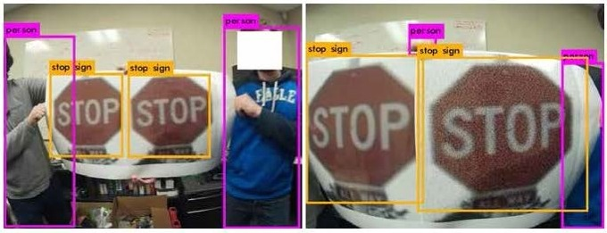
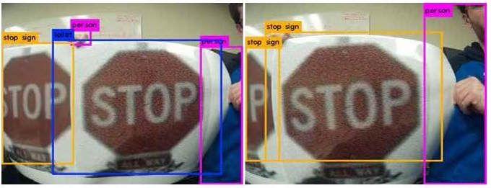
Angle effects - hypothesis
Detected
adversarial does not work
Detected
adversarial does not work
Not Detected
adversarial works
Detected
adversarial does not work

Slide 14
Detection Rate

Slide 15
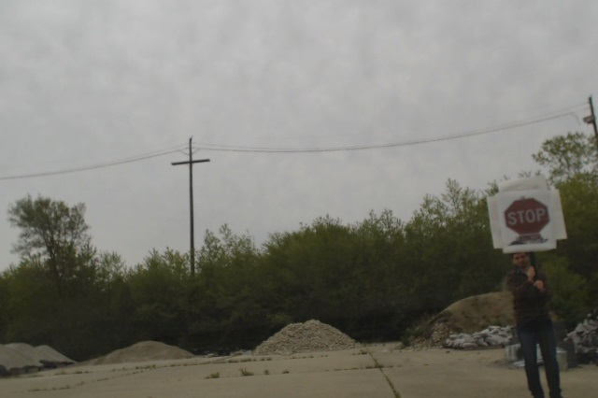
Autonomous vehicle meets adversarial stop sign

Slide 16
Autonomous Example 1
Notes:
YOLO detector, printed stop sign is smaller.
Adversarial stop signs: Our stop sign is a little bit smaller. Typical detector behavior in the real situation.

Slide 17
Autonomous Example 2

Slide 18
Autonomous Example 2

Slide 19
Autonomous Example 2

Slide 20
Autonomous Example 3

Slide 21
Autonomous Example 3

Slide 22
Autonomous Example 3

Slide 23
Can one construct examples that are adversarial for most viewing conditions?
If YES:
The construction offers insights into the internal representation of patterns by deep networks.
If NO:
Adversarial examples might be less important in the security setting

Slide 24
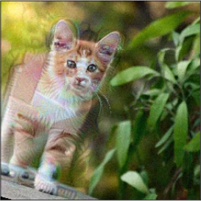
OpenAI’s blog post
Ensemble adversarial examples

Slide 25
Our response
This cat has obviously been modified
Cats aren’t stop signs because
- viewing conditions aren’t the same
- textures are very different
Physical world is different: 3D world, lighting, and so on.

Slide 26
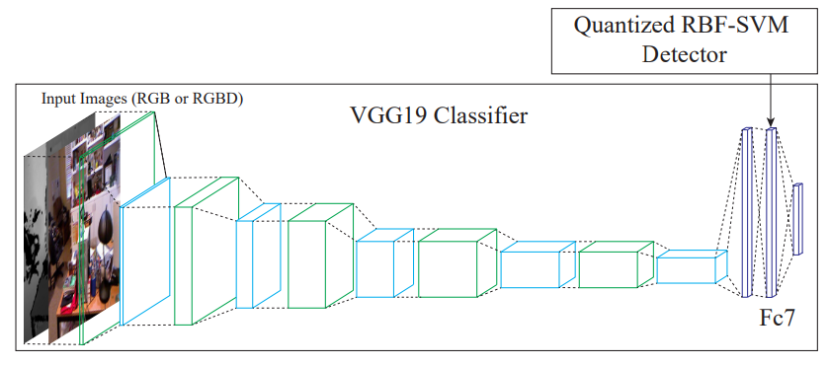
SafetyNet
We have experimental evidence that adversarial examples produce strange activation patterns in high-level ReLUs. Detecting and rejecting examples that do this is a quite reliable way of rejecting adversarial examples, and seems to be hard to attack. See Arxiv, ICCV 2017.

Slide 27
NO Need to Worry about Adversarial Examples in Object Detection in Autonomous Vehicles
Jiajun Lu*, Hussein Sibai*, Evan Fabry, David Forsyth
University of Illinois at Urbana Champaign
{jlu23, sibai2, efabry2, daf}@illinois.edu

